Slide 1
Linked List
Alternate approach to maintaining an array of elements
Rather than allocating one large group of elements, allocate elements as needed
Q: how do we know what is part of the array?
A: have the elements keep track of each other
use pointers to connect the elements together as a LIST of things

Slide 2
Outline
Linked list
basic terms (data, link, node)
type definition
visualization
operations
init, insert, read group, find, print, delete, sort
variations
dummy head node
sorted list

Slide 3
Limitation of Arrays
An array has a limited number of elements
routines inserting a new value have to check that there is room
Can partially solve this problem by reallocating the array as needed (how much memory to add?)
adding one element at a time could be costly
one approach - double the current size of the array
A better approach: use a Linked List

Slide 4
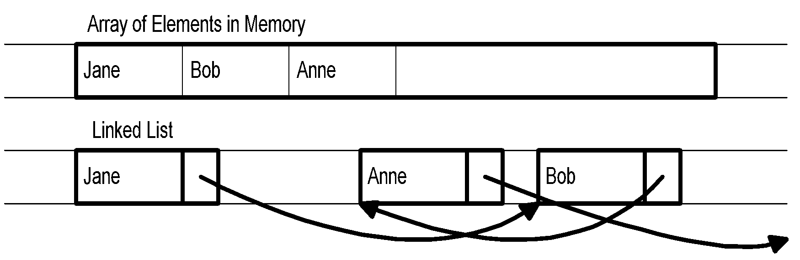
Dynamically Allocating Elements
Allocate elements one at a time as needed, have each element keep track of the next element
Result is referred to as linked list of elements, track next element with a pointer

Slide 5
Linked List Notes
Need way to indicate end of list (NULL pointer)
Need to know where list starts (first element)
Each element needs pointer to next element (its link)
Need way to allocate new element (use malloc)
Need way to return element not needed any more (use free)
Divide element into data and pointer

Slide 6
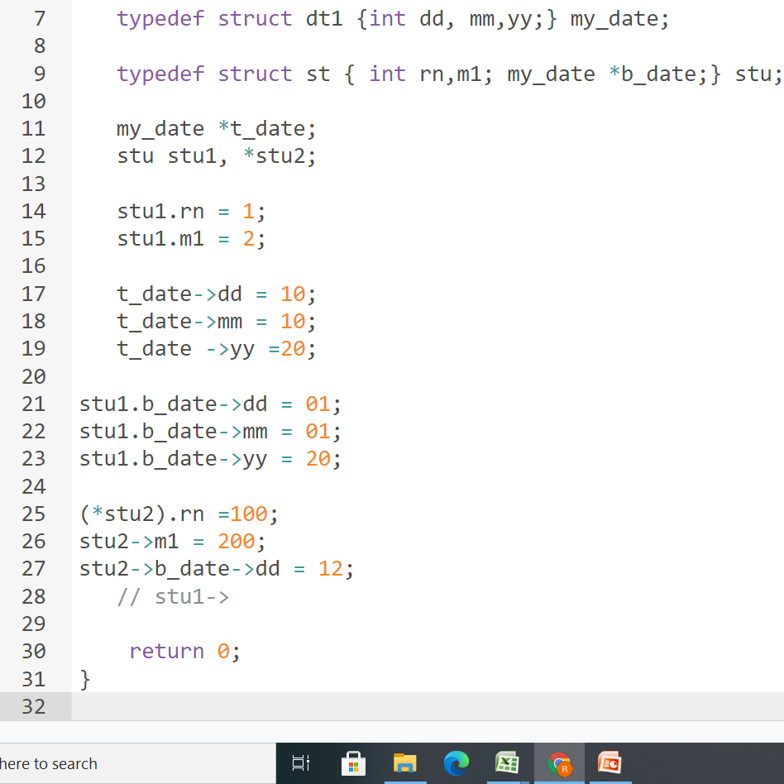
Sample C practice

Slide 7
My_date *t_date;
(*T-date).dd
T_date🡪dd
46
Int *p 1000
50
P = malloc()
*p =250
&p =50
1000
250

Slide 8
Types of Linked List
Simple Linked List − Item navigation is forward only.
Doubly Linked List − Items can be navigated forward and backward.
Circular Linked List − Last item contains link of the first element as next and the first element has a link to the last element as previous.

Slide 9
Basic Operations
Insertion − Adds an element at the beginning of the list.
Deletion − Deletes an element at the beginning of the list.
Display − Displays the complete list.
Search − Searches an element using the given key.
Delete − Deletes an element using the given key.

Slide 10
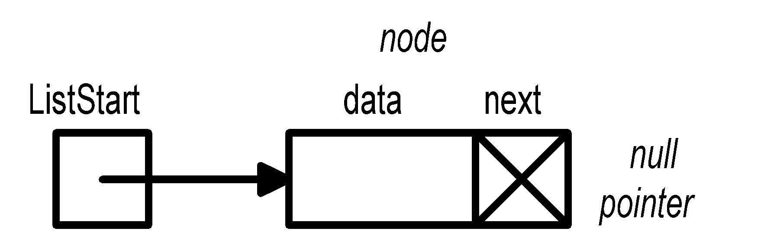
Linked List Type
Type declaration:
typedef struct ESTRUCT {
DataType data; /* DataType is type for element of list */
struct ESTRUCT *next;
} EStruct, *EPtr; (For Simplicity)
Pointer to first element:
Estruct *node
EPtr ListStart;
/* ListStart points to first element of list
*ListStart is first element struct
ListStart->data is data of first element
ListStart->next points to second element */

Slide 11

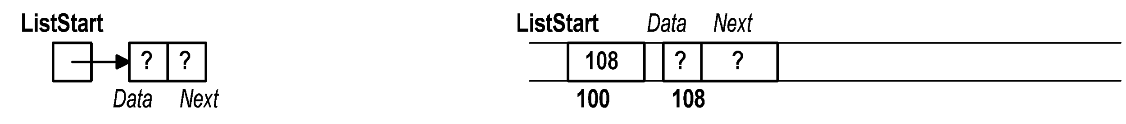
Sample Linked List Operations
void main() { /* Assume data is int */
EPtr ListStart = NULL;
/* safest to give ListStart an initial legal
value -- NULL indicates empty list */
ListStart = (EPtr) malloc(sizeof(EStruct));
/* ListStart points to memory allocated at
location 108 */

Slide 12
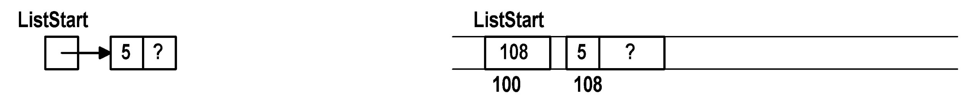
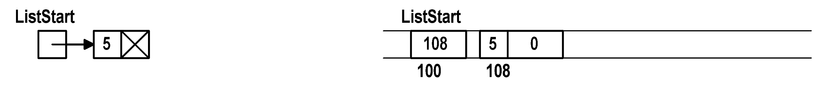
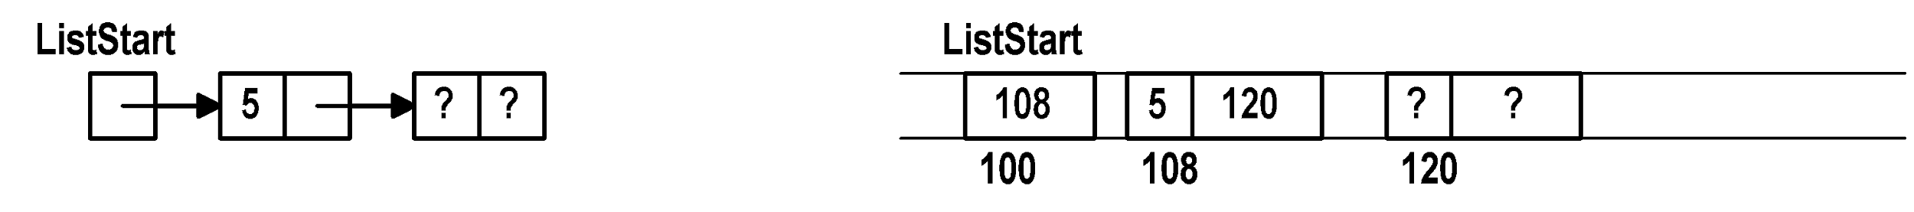

Sample Linked List Ops (cont)
ListStart->data = 5;
ListStart->next = NULL;
ListStart->next = (EPtr) malloc(sizeof(EStruct));
ListStart->next->data = 9;
ListStart->next->next = NULL;

Slide 13
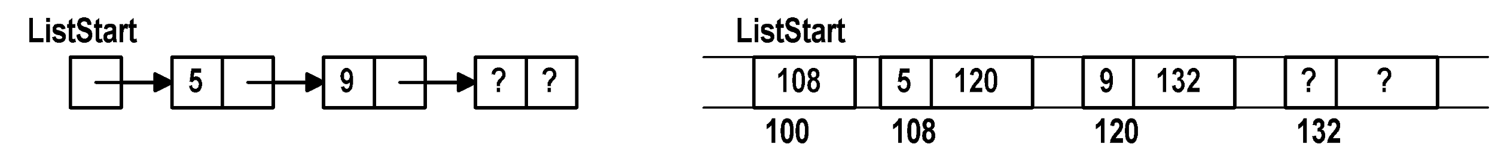
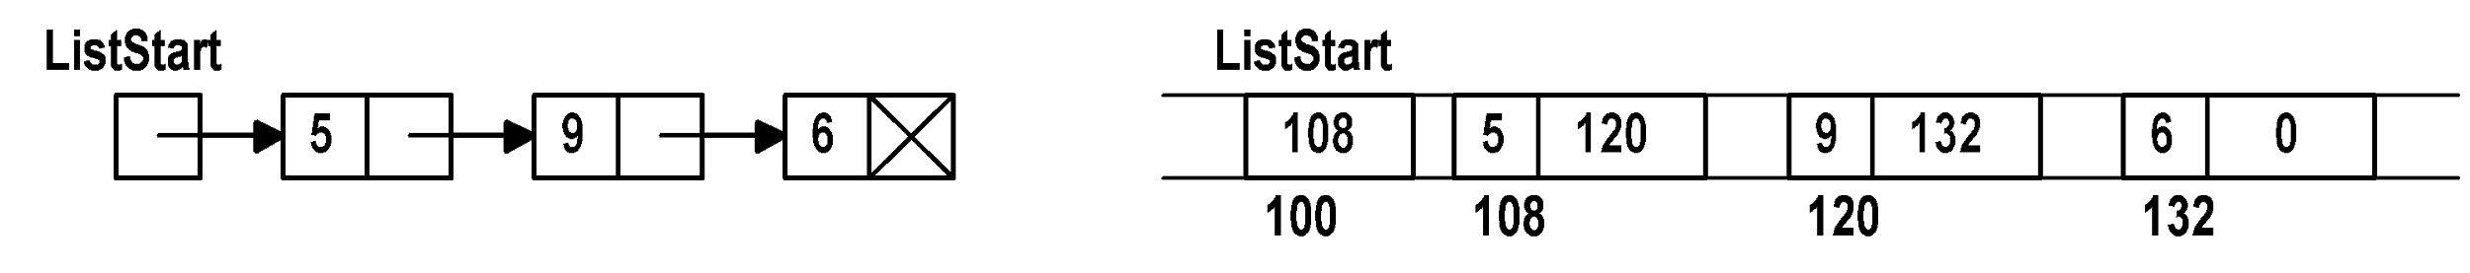
Sample Linked List Ops (cont)
ListStart->next->next = (EPtr) malloc(sizeof(EStruct));
ListStart->next->next->data = 6;
ListStart->next->next->next = NULL;
/* Linked list of 3 elements (count data values):
ListStart points to first element
ListStart->next points to second element
ListStart->next->next points to third element
and ListStart->next->next->next is NULL to
indicate there is no fourth element */
We can write : Second = LinkStart->next[

Slide 14
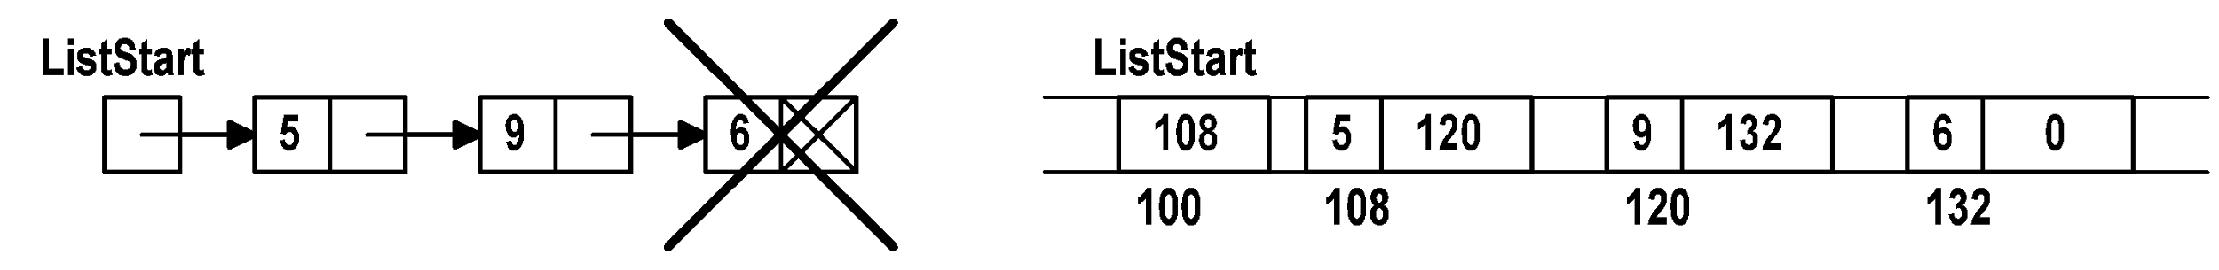

Sample Linked List Ops (cont)
/* To eliminate element, start with free operation */
free(ListStart->next->next);
/* NOTE: free not enough -- does not change memory
Element still appears to be in list
But C might give memory away in next request
Need to reset the pointer to NULL */
ListStart->next->next = NULL;
/* Element at 132 no longer part of list (safe to
reuse memory) */

Slide 15
Common Mistakes
Dereferencing a NULL pointer
ListStart = NULL;
ListStart->data = 5; /* ERROR */
Using a freed element
free(ListStart->next);
ListStart->next->data = 6; /* PROBLEM */
Using a pointer before set
ListStart = (EPtr) malloc(sizeof(EStruct));
ListStart->next->data = 7; /* ERROR */

Slide 16
List Initialization
Certain linked list ops (init, insert, etc.) may change element at start of list (what ListStart points at)
to change what ListStart points to could pass a pointer to ListStart (pointer to pointer)
alternately, in each such routine, always return a pointer to ListStart and set ListStart to the result of function call (if ListStart doesn’t change it doesn’t hurt)
EPtr initList() {
return NULL;
}
ListStart = initList();

Slide 17
A Helper Function
Build a function used whenever a new element is needed (function always sets data, next fields):
EPtr newElement(DataType ndata, EPtr nnext) {
EPtr newEl = (EPtr) malloc(sizeof(EStruct));
newEl->data = ndata;
newEl->next = nnext;
return newEl;
}

Slide 18
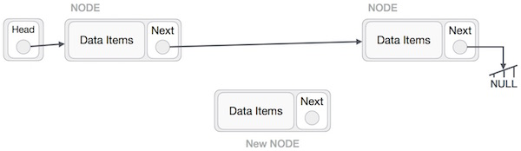
Insertion basics
First, create a node using the same structure and find the location where it has to be inserted.
Insert B (NewNode), between A (LeftNode) and C (RightNode).
Set B->right Pointer
Set A-> right Pointer
A
C
B

Slide 19
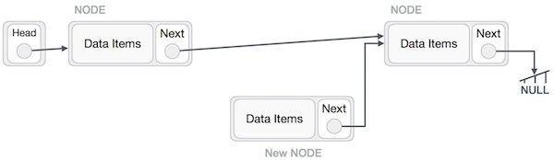
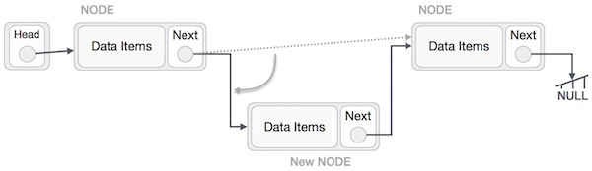
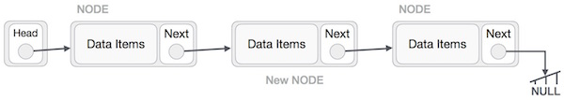

Slide 20
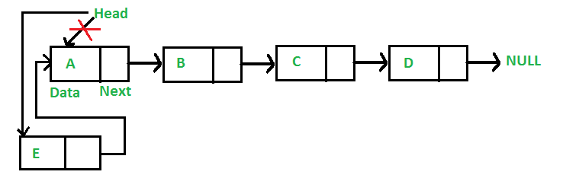
List Insertion (at front)
Add new element to list:
Make new element’s next pointer point to start of list
Make pointer to new element start of list
EPtr insertF(EPtr start, DataType dnew) {
return newElement(dnew,start);
}
To use, get new value to add (ask user, read from file, whatever), then call insertF:
ListStart = insertF(ListStart,NewDataValue);

Slide 21
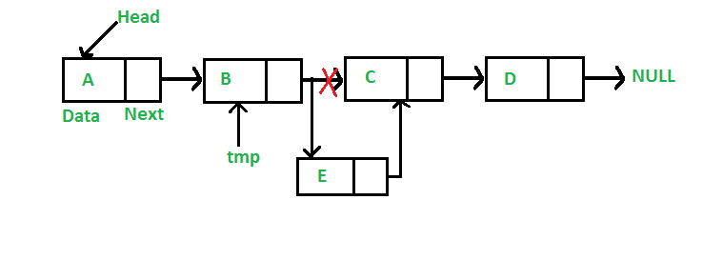
Middle Insertion

Slide 22
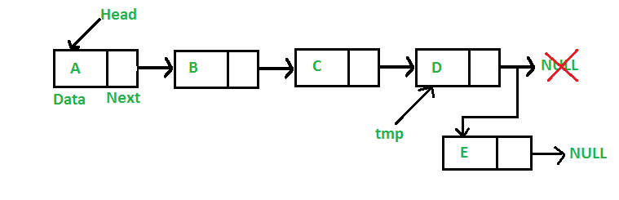
Rear Insertion

Slide 23
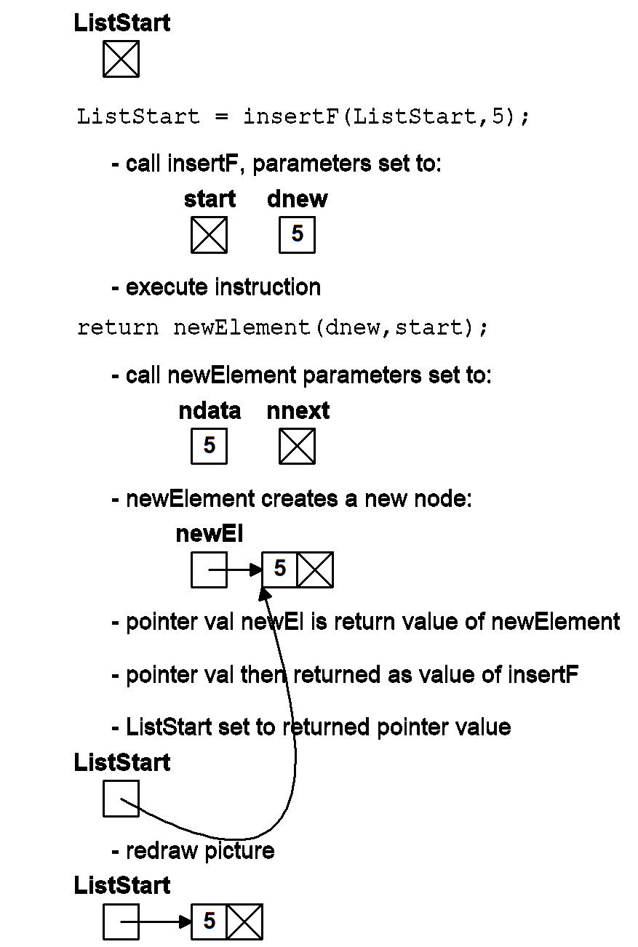
Insert Example

Slide 24
Insert Example

Slide 25
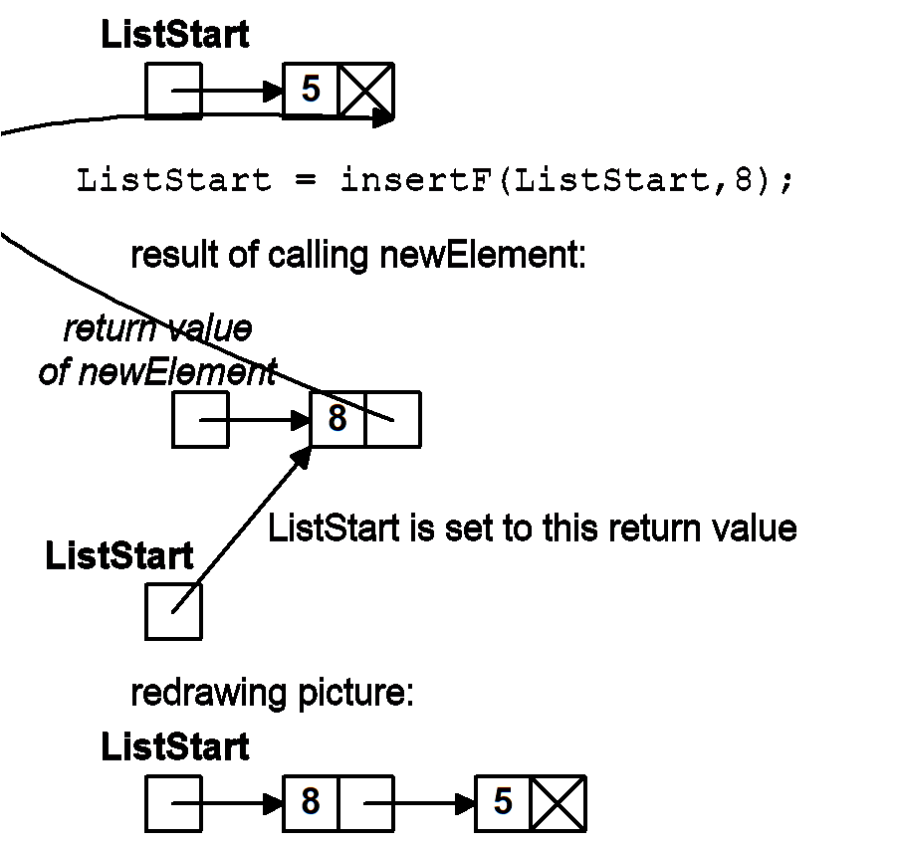
Insert Example

Slide 26
Insert at End
Need to find end of list -- use walker (temporary pointer) to “walk” down list
Typedef Struct node{ } *Eptr, node1
EPtr insertE(EPtr start, DataType dnew)
// (node1 *) (Eptr *start……); {
EPtr last = start; /* Walker */
//node1 *last = start……….
if (start == NULL) /* if list empty, add at */
return newElement(dnew,NULL); /* start */
else {
while (last->next != NULL) /* stop at */
last = last->next; /* last item */
last->next = newElement(dnew,NULL);
return start; /* start doesn’t change */ } }

Slide 27
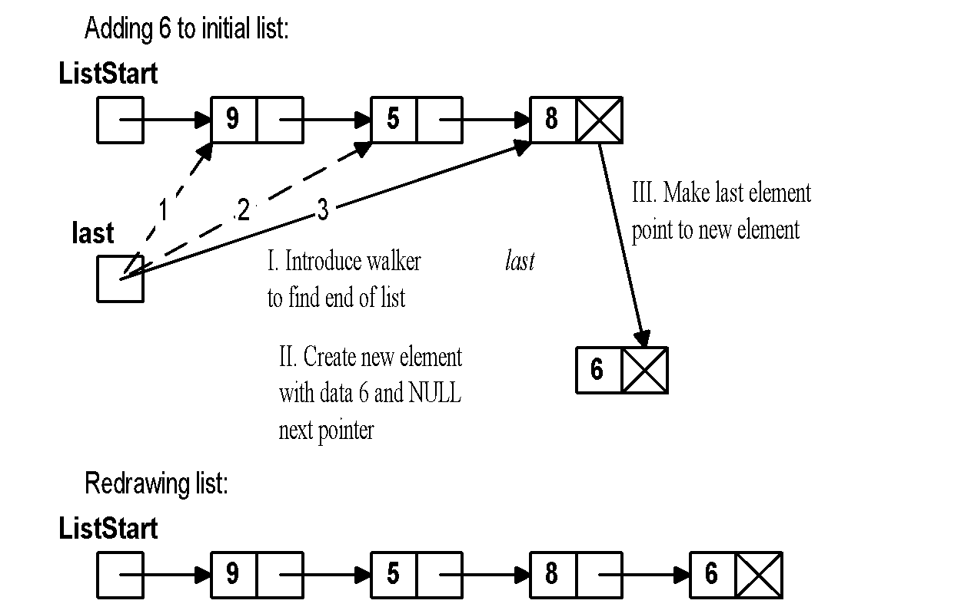
Insert at End Example

Slide 28
Reading a Group of Elements
EPtr readGroup(EPtr start, FILE *instream) {
DataType dataitem;
while (readDataSucceeds(instream,&dataitem))
/* Add new item at beginning */
start = newElement(dataitem,start);
return start;
}
/* Assume DataType is int: */
int readDataSucceeds(FILE *stream, int *data) {
if (fscanf(stream,”%d”,data) == 1)
return 1;
else
return 0;
}

Slide 29
Reading Group - Add at End
EPtr readGroupE(EPtr start, FILE *instream) {
EPtr last;
DataType data;
/* Try to get first new item */
if (!readDataSucceeds(instream,&data))
return start; /* if none, return initial list */
else { /* Add first new item */
if (start == NULL) {
/* If list empty, first item is list start */
start = newElement(data,NULL);
last = start;
}

Slide 30
Reading Group - Add at End (cont)
else { /* List not initially empty */
last = start;
while (last->next != NULL) /* Find end */
last = last->next;
/* Add first element at end */
last->next = newElement(data,NULL);
last = last->next;
}
}
/* Add remaining elements */
while (readDataSucceeds(instream,&data)) {
last->next = newElement(data,NULL);
last = last->next;
}
return start;
}

Slide 31
Printing a List
Use a walker to examine list from first to last
void printList(EPtr start) {
EPtr temp = start;
while (temp != NULL) {
printData(temp->data);
temp = temp->next;
}
}

Slide 32
Finding an Element in List
Return pointer to item (if found) or NULL (not found)
EPtr findE(EPtr start, DataType findI) {
EPtr findP = start; /* walker */
while ((findP != NULL) &&
(findP->data is not the same as findI))
findP = findP->next;
return findP;
}

Slide 33
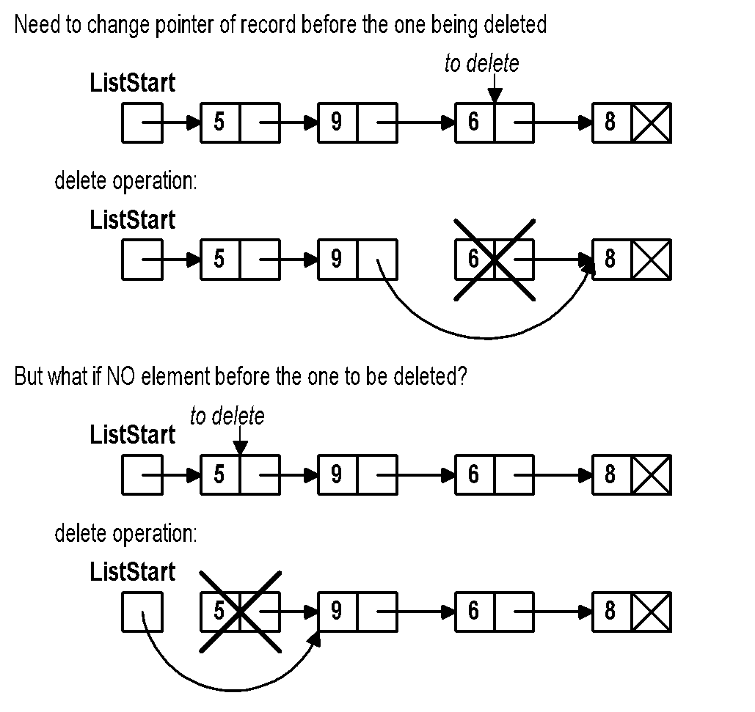
Deleting an Element

Slide 34
Deletion Code
EPtr delete(EPtr start, DataType delI) {
EPtr prev = NULL;
EPtr curr = start;
while ((curr != NULL) && (curr->data is not delI)) {
prev = curr;
curr = curr->next;
}
if (curr == NULL)
printf(“Item to delete not found\n”);
else {
if (prev == NULL)
start = start->next;
else
prev->next = curr->next;
free(curr);
}
return start;
}

Slide 35
Selection Sorting Linked List
EPtr sort(EPtr unsorted) {
EPtr sorted = NULL;
EPtr largest, prev;
while (unsorted != NULL) {
prev = findItemBeforeLargest(unsorted);
if (prev == NULL) {
largest = unsorted;
unsorted = unsorted->next;
}
else {
largest = prev->next;
prev->next = largest->next;
}
largest->next = sorted;
sorted = largest;
}
return sorted;
}

Slide 36
Item Before Largest
EPtr findItemBeforeLargest(EPtr start) {
EPtr prevlargest = NULL;
EPtr largest = start;
EPtr prev = start;
EPtr curr = start->next;
while (curr != NULL) {
if (curr->data bigger than largest->data) {
prevlargest = prev;
largest = curr;
}
prev = curr;
curr = curr->next;
}
return prevlargest;
}
Notes:
‹#›

Slide 37
Reverse Operation
Head🡪 last node and Current Head🡪 Next = null
First, we traverse to the end of the list.
It should be pointing to NULL.
But the last node to point PREV node

Slide 38
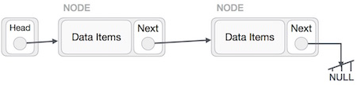
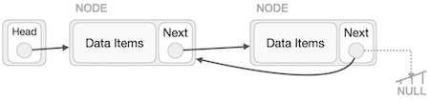
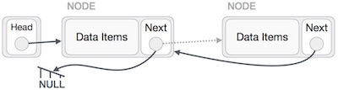
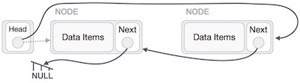


Slide 39
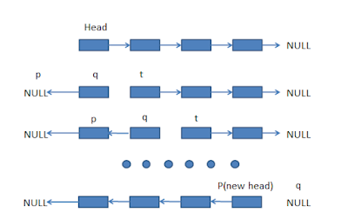
Reverse list (cont)
Prev = Start
Cur = start🡪Next
While cur🡪 Next <> Null
Temp = Cur
Cur = Cur 🡪 Next
Temp🡪Next = Prev

Slide 40
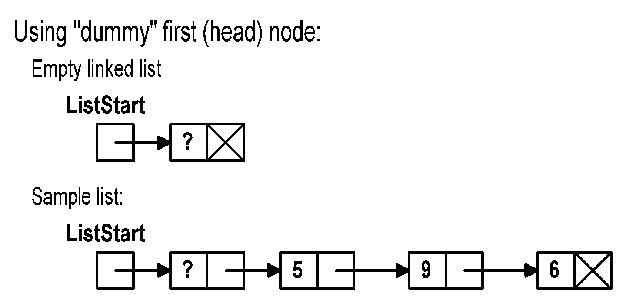
Linked List Variation: Dummy Head Node
Why?
No special case for inserting/deleting at beginning
ListStart does not change after it is initialized
Disadvantage
cost of one extra element

Slide 41
DH List Initialization/Insert
EPtr initList() {
EPtr ListStart =
(EPtr) malloc(sizeof(EStruct));
ListStart->next = NULL;
return ListStart;
}
void insertF(EPtr start, DataType dnew) {
start->next =
newElement(dnew,start->next);
}

Slide 42
DH Inserting at End
void insertE(EPtr start, DataType dnew) {
EPtr last = start; /* Walker */
/* No special list is empty case */
while (last->next != NULL)
last = last->next;
last->next = newElement(dnew,NULL);
}

Slide 43
DH Printing a List
Have walker start at second element
void printList(EPtr start) {
EPtr temp = start->next;
while (temp != NULL) {
printData(temp->data);
temp = temp->next;
}
}

Slide 44
DH Deletion Code
void delete(EPtr start, DataType delI) {
EPtr prev = start;
EPtr curr = start->next;
while ((curr != NULL) && (curr->data is not delI)) {
prev = curr;
curr = curr->next;
}
if (curr == NULL)
printf(“Item to delete not found\n”);
else {
prev->next = curr->next;
free(curr);
}
}

Slide 45
Linked List Variation: Sorted List
Idea: keep the items on the list in a sorted order
sort based on data value in each node
advantages:
already sorted
operations such as delete, find, etc. need not search to the end of the list if the item is not in list
disadvantages
insert must search for the right place to add element (slower than simply adding at beginning)

Slide 46
Sorted Insert (with Dummy Head)
void insertS(EPtr start, DataType dnew) {
EPtr prev = start;
EPtr curr = start->next;
while ((curr != NULL) &&
(dnew is bigger than curr->data)) {
prev = curr;
curr = curr->next;
}
prev->next = newElement(dnew,curr);
}

